Slide 1
FINAL PROJECTS
COMPUTER INFORMATION TECNOLOGY
CV RESUME
SPREAD SHEET

Slide 2
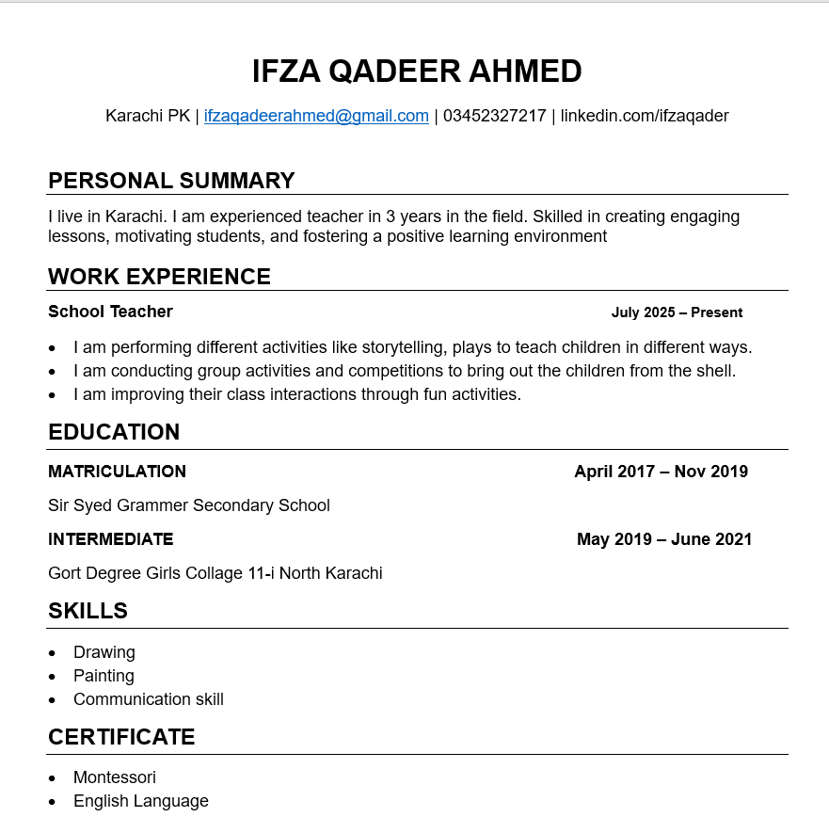
My resume
A resume is a summary of my skills, experience, and education .It highlights
my qualifications .It includes contact details, work history, and achievements.

Slide 3
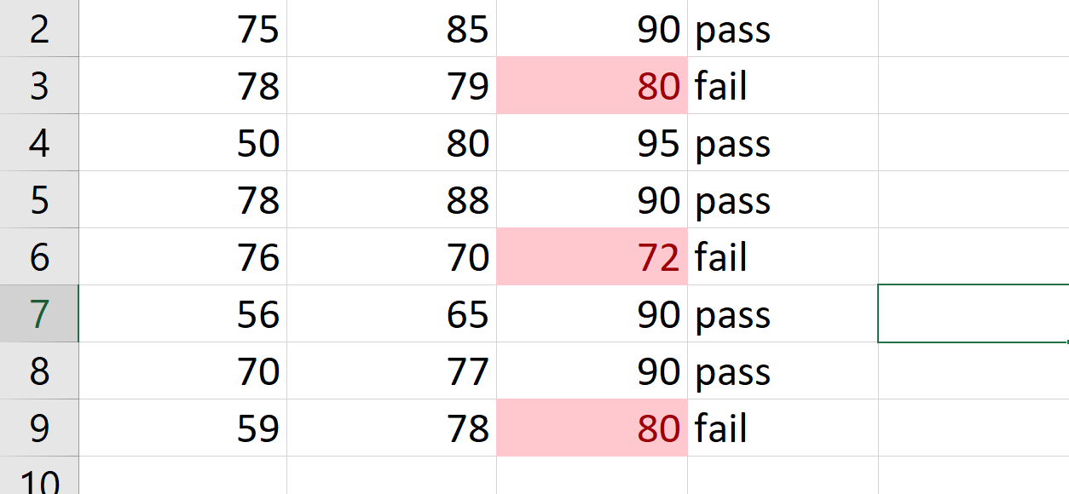
Conditional Formatting
Conditional formatting is a tool in spreadsheets .It changes cell appearance based on set rules .Colors, fonts, or icons are applied automatically. Used to highlight trends, errors, or key values. It makes data easier to read and analyze.

Slide 4
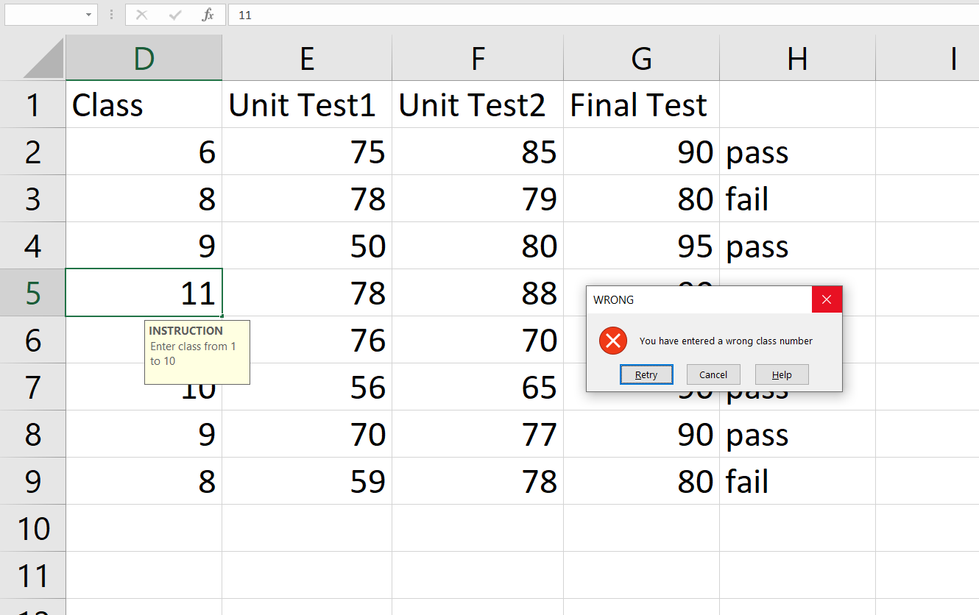
Data validation
Here I have data validation and restricted to only enter a number between 1 to 10 and when he enters another number he gets an error.

Slide 5
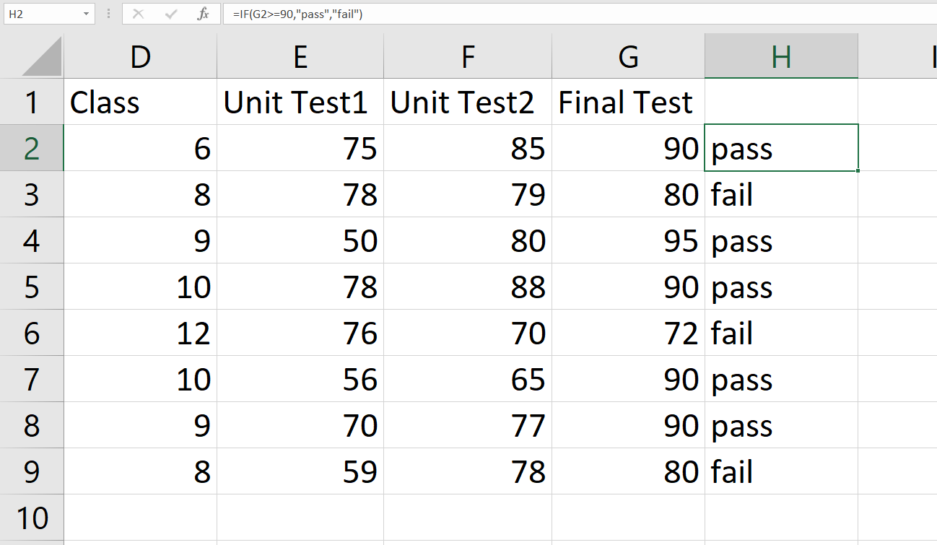
If in excel
The IF function in Excel checks if a condition
is true or false. It returns one value if the condition is true. Returns another value if the condition is false. It helps make decisions in formulas.

Slide 6
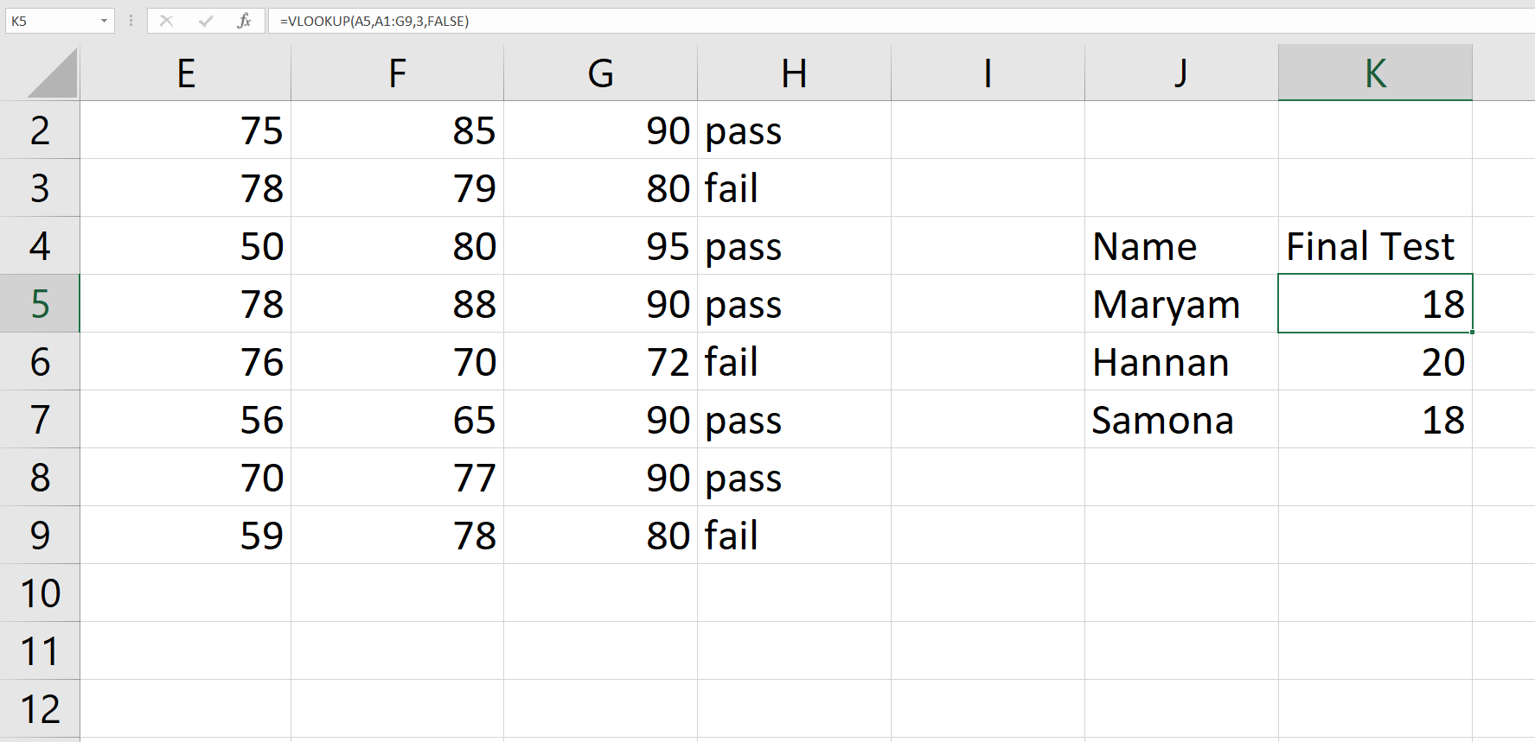
VLOOKUP
VLOOKUP is a function in Excel used to find data in a table. It searches for a value in the first column. Then returns a value from the same row in another column. Useful for looking up and matching data quickly.

Slide 7
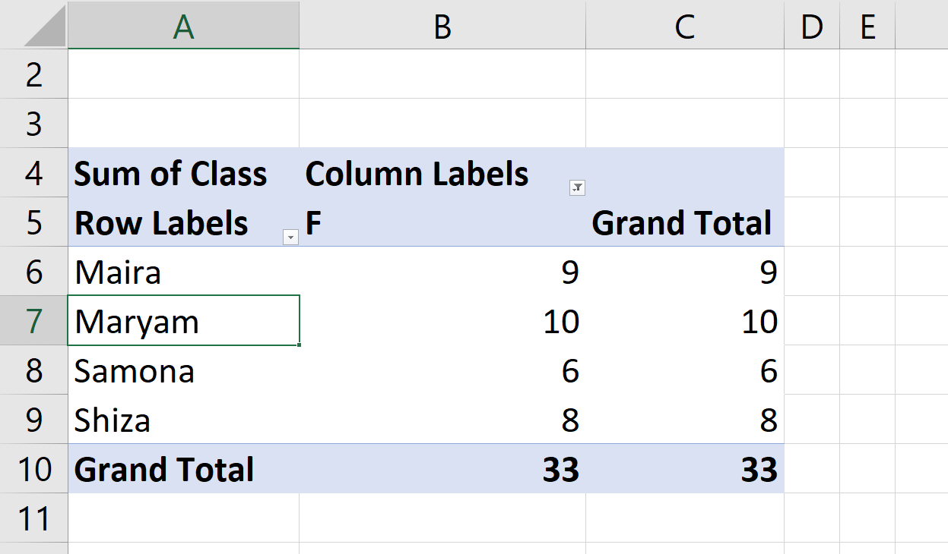
Pivot Table
A Pivot Table in Excel is a tool to summarize large data sets. It helps analyze, explore, and organize data easily. You can group, sort, and filter information quickly. It allows calculations like sums, averages, and counts. Drag-and-drop fields to customize your view. Great for creating dynamic and interactive reports.

Slide 8
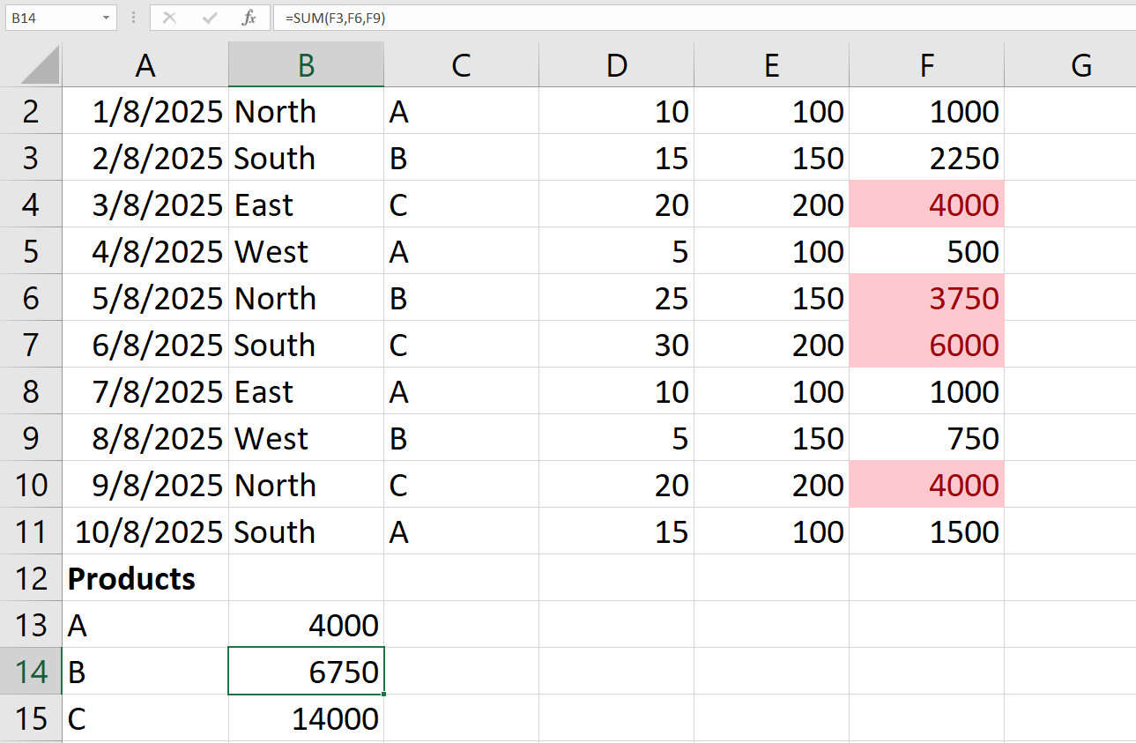


Sum in excel
The SUM function in Excel adds numbers together. It can add individual values or a range of cells. It helps quickly calculate totals. Commonly used for simple math in spreadsheets.

